Slide 1
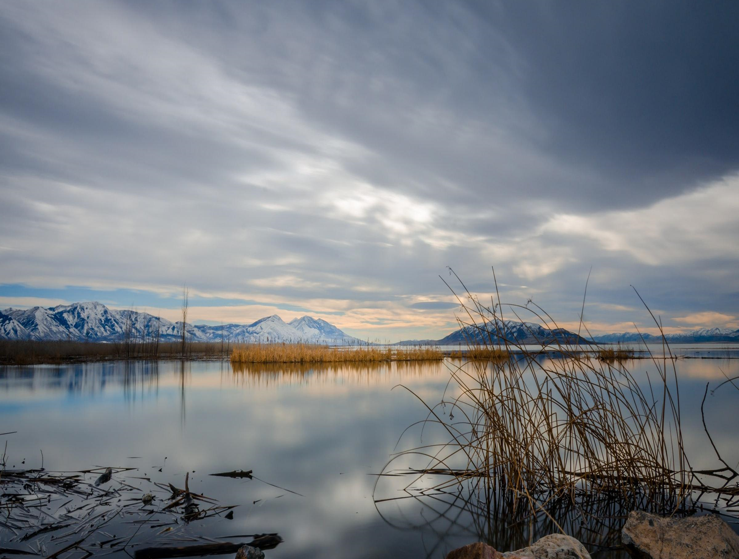
2023 WMPP Survey Covering 2022
Harry Campbell, P.E.
September, 2023

Slide 2
MWPP Survey Outline
Financial Planning
Utah Sewer Management Program
Support for Certification of Wastewater Works Operators
General Information about Facilities

Slide 3
Survey Groups
Collections 64
Collections & Treatment 41
Small Lagoons 29
Treatment 8 Total 142
Total Treatment 78

Slide 4
2020 MWPP Survey
65% of Mailing List (Mailing List 220)
Qualtrics Software
Municipal Wastewater
Year to Year comparisons
Financial Planning
Improved Operations (Asset Management)

Slide 5
MWPP Survey Coverage
44 of 65 UPDES Municipal Permits (68%)
29 of 61 Operating Permits (48%)
134 Collections Facilities
151 Collection/Treatment Systems

Slide 6
Funding Sources
Fund | % of Use | Average | Max | Min
User Fee 91% |  | $35.33 | $98.92 | $8.33
Impact Fee 68% |  | $2,630 | $11,016 | $113
Tax 16% |  | $2.2 mil | $10.9 mil | $8,000

Slide 7
Funding Sources Used by Participants
No Fees – 17 (9 cities, Deseret Chemical Depot, Bryce Canyon NP, Hite Marina NPS, South Valley WRF, Snyderville Basin EC & SC, So. Davis N & S, SLC WRF, CVWRF)
User Fees Only – 31
User Fees & Impact Fees -- 72 So. Weber, Timpanogos
User Fee, Impact Fee, Tax -- 20
User Fees & Tax -- 2

Slide 8
Part I General Questions
Are sewer revenues maintained in a dedicated purpose enterprise/district account?
Are you collecting 95% or more of your anticipated sewer revenue?

Slide 9
Part I General Questions
Are Debt Service Reserve Fund requirements being met?
Do you have a water and/or sewer customer assistance program (CAP)?

Slide 10
Part II Operating Revenues and Reserves
Are property taxes or other assessments applied to the sewer systems?
Are sewer revenues sufficient to cover operations & maintenance costs, and repair & replacement costs (OM&R) at this time?

Slide 11
Part II Operating Revenue and Reserves
Are projected sewer revenues sufficient to cover OM&R costs for the next five years?
Does the sewer system have sufficient staff to provide proper OM&R?

Slide 12
Part II Operating Revenue and Reserves
Has a repair and replacement sinking fund been established for the sewer system?
Is the repair & replacement sinking fund sufficient to meet anticipated needs?

Slide 13
Part III Capital improvements Revenue and Reserves
Are sewer revenues sufficient to cover all costs of current capital improvements projects?
Has a Capital Improvements Reserve Fund been established to provide for anticipated capital improvement projects?

Slide 14
Part III Capital Improvements Revenues and Reserves
Are projected Capital Improvements Reserve Funds sufficient for the next five years?
Are projected Capital Improvements Reserve Funds sufficient for the next ten years?

Slide 15
Part III Capital Improvements Revenues and Reserves
Are projected Capital Improvements Reserve Funds sufficient for the next twenty years?

Slide 16
Part IV Fiscal Sustainability Review
Have you completed a Rate Study within the last five years?
Do you charge Impact fees?

Slide 17
Part IV Fiscal Sustainability Review
Have you completed an Impact Fee Study in accordance with UCA 11-36a-3 within the last five years?
Do you maintain a Plan of Operations?

Slide 18
Part IV Fiscal Sustainability Review
Have you updated your Capital Facility Plan within the last five years?
Do you use an Asset Management system for your sewer systems?

Slide 19
Part IV Fiscal Sustainability Review
Do you know the total replacement cost of your sewer system capital asset?
Do you fund sewer system capital improvements annually with sewer revenues at 2% or more of the total replacement cost?

Slide 20
Capital Improvement Projects (2022)
How Many Projects?
’22 | ’23-’27 | ’28-‘32 | ‘33–‘37 | ‘38-’42
51 | 33 | 19 | 19 | 17
19 | 26 | 24 | 19 | 21
15 | 14 | 16 | 11 | 12
11 | 18 | 14 | 18 | 13
3 | 6 | 3 | 2 | 1
2 | 7 | 2 | 0 | 2
0 to $1 M
$1 M to $5 M
$5 M to $10 M
$10 M to $50 M
$50 M to $100 M
$100 M to more

Slide 21
2022 Capital Plans
Total Capital Plans $938,940,855

Slide 22
2023 – 2027 Capital Plans

Slide 23
2028 – 2032 Capital Plans
Total Capital Plans, $1,146,427,464

Slide 24
2033 – 2037 Capital Plans
Total Capital Plans $611,467,426

Slide 25
2038 – 2042 Capital Plans

Slide 26
2022 - 2042 (20-yrs) Capital Plans

Slide 27
Questions?
Harry Campbell
801-536-4391
hcampbell@utah.gov

